Slide 1
Non-Convex Optimization for Rotation Search: Theory and Algorithms
Talk @Center for Applied Mathematics of Henan Province, China (Virtual)
Liangzu Peng (lpeng25@jhu.edu)
Johns Hopkins University
September 23, 2022

Slide 2
Rotation Search
Part I (Theory):
Semidefinite Relaxations of Truncated Least-Squares in Robust Rotation Search: Tight or Not
European Conference on Computer Vision (ECCV), 2022
Liangzu Peng, Mahyar Fazlyab, René Vidal
Part II (Algorithms):
ARCS: Accurate Rotation and Correspondences Search
Computer Vision and Pattern Recognition (CVPR), 2022
Liangzu Peng, Manolis C. Tsakiris, René Vidal
This work was supported by grants NSF 1704458, NSF 1934979, ONR MURI 503405-78051,
and the Northrop Grumman Mission Systems Research in Applications for Learning Machines (REALM) initiative.

Slide 3
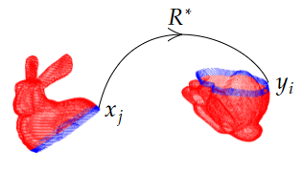
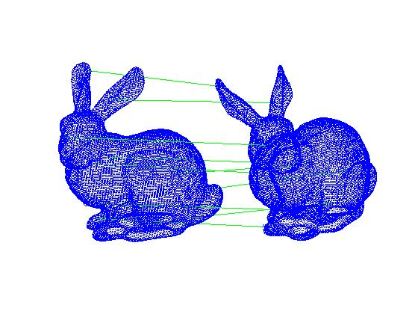
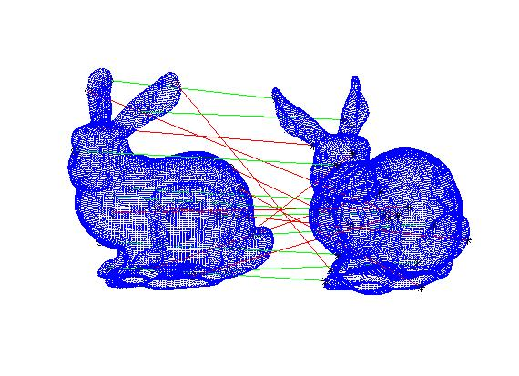
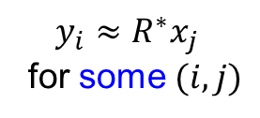
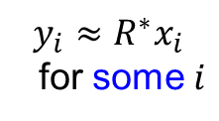
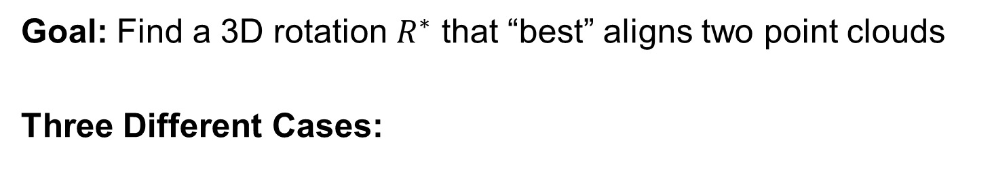
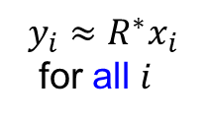
Rotation Search: Problem Setup
Goal: Find a 3D rotation $R^{∗}$ that “best” aligns two point clouds
Three Different Cases:
(2) With Outliers
(3) Correspondence-Less
(Partially Overlapped)
(1) Outlier-Free
$$y_{i}≈R^{∗}x_{i}$$
for all $i$
$$y_{i}≈R^{∗}x_{i}$$
for some $i$
$$y_{i}≈R^{∗}x_{j}$$
for some $(i,j)$

Slide 4
Part I: Theory
Semidefinite Relaxations of Truncated Least-Squares in Robust Rotation Search: Tight or Not
ECCV 2022
Liangzu Peng, Mahyar Fazlyab, René Vidal

Slide 5
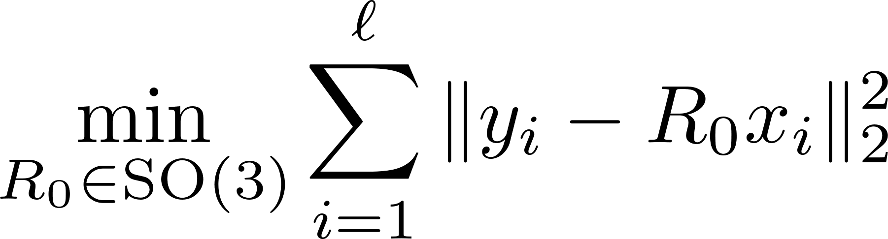

The Outlier-Free Case
Wahba’s Problem (Wahba, 1965)
${{y_{i}≈R}_{0}^{∗}x}_{i}, i=1,…,l$
$R_{0}^{∗}∈SO\left(3\right)$
Optimization (Least-Squares):
G. Wahba. A least squares estimate of satellite attitude. SIAM Review, 1965

Slide 6

(Outlier-)Robust Rotation Search
Inliers: ${{y_{i}≈R}_{0}^{∗}x}_{i}$
Outliers: $(x_{i},y_{i})$ arbitrary

Slide 7
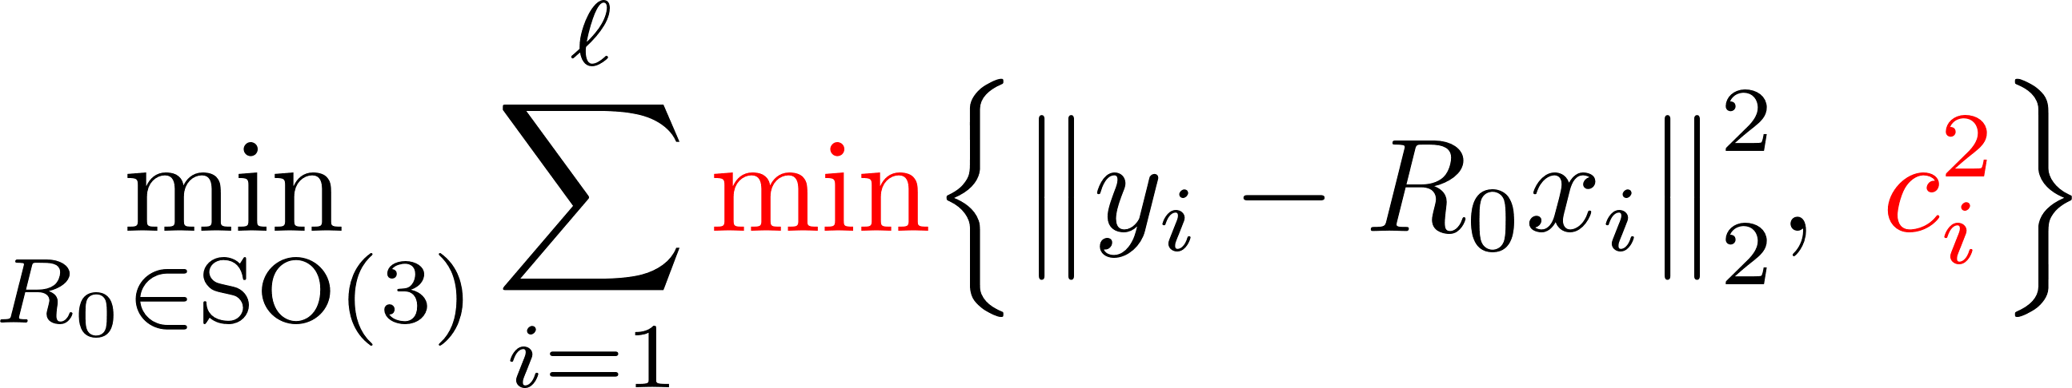
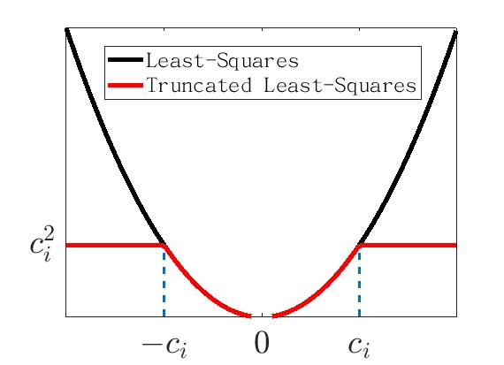
Truncated Least-Squares (Rotation)
(TLS-R)
(Huber, 1964) Truncation Parameter
Challenges of solving (TLS-R):
Non-Convexity
Non-Smoothness
Inapproximable (Antonante et al., 2021)
H. Yang and L. Carlone. A quaternion-based certifiably optimal solution to the Wahba problem with outliers. ICCV 2019.

Slide 8
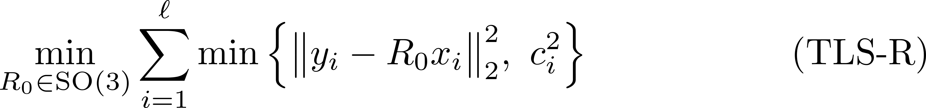
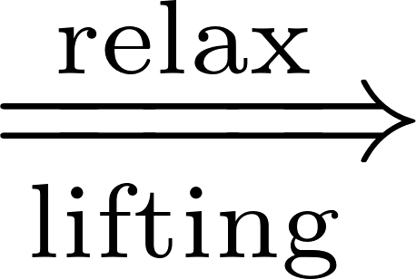

Overview 1/2
1. From (TLS-R) to Its Semidefinite Relaxations
We will derive (based on Yang & Carlone [1]):
(TLS-R) (TLS-Q) (QCQP) (SDR)
Rotation “replaced” by Unit Quaternion
[1] H. Yang and L. Carlone. A quaternion-based certifiably optimal solution to the Wahba problem with outliers. ICCV 2019.

Slide 9

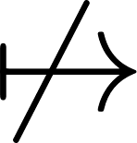
Overview 2/2
2. Tightness of (SDR): mi casa es su casa?
(TLS-R) (TLS-Q) (QCQP) (SDR)
We provide conditions, under which:
global minimizer of (SDR) global minimizer of (QCQP)
or equivalently (SDR) is tight or not
L. Peng, M. Fazlyab, R. Vidal, Semidefinite relaxations of truncated least-squares in robust rotation search: Tight or not, ECCV 2022

Slide 10

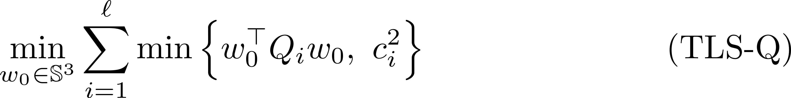

From (TLS-R) to (TLS-Q)
(TLS-R) (TLS-Q) (QCQP) (SDR)
Key Idea: 3D rotations $R_{0} \overset{⇔}{ }$ unit quaternions $w_{0}$
Change of
Variables
Change of Data and Residual

Slide 11
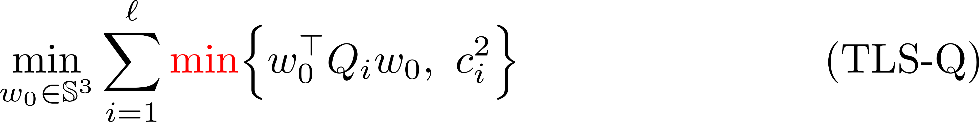
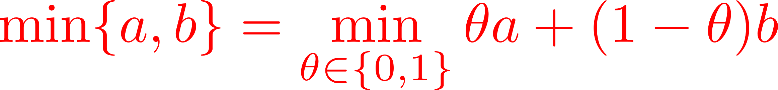
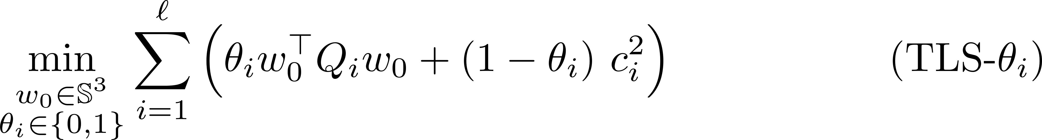
From (TLS-Q) to (QCQP) 1/4
(TLS-R) (TLS-Q) (QCQP) (SDR)
cubic polynomial in entries of the unknowns

Slide 12
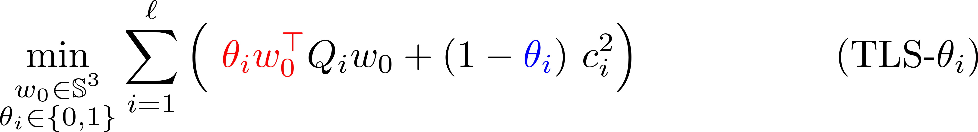
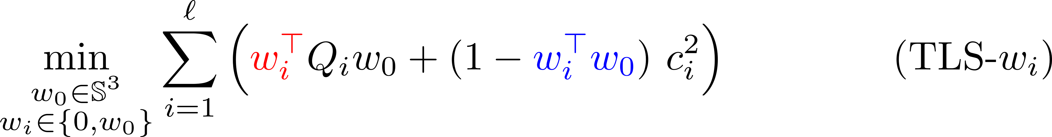
From (TLS-Q) to (QCQP) 2/4
(TLS-R) (TLS-Q) (QCQP) (SDR)
Quadratic Obj.
[1] H. Yang and L. Carlone. A quaternion-based certifiably optimal solution to the Wahba problem with outliers. ICCV 2019.

Slide 13
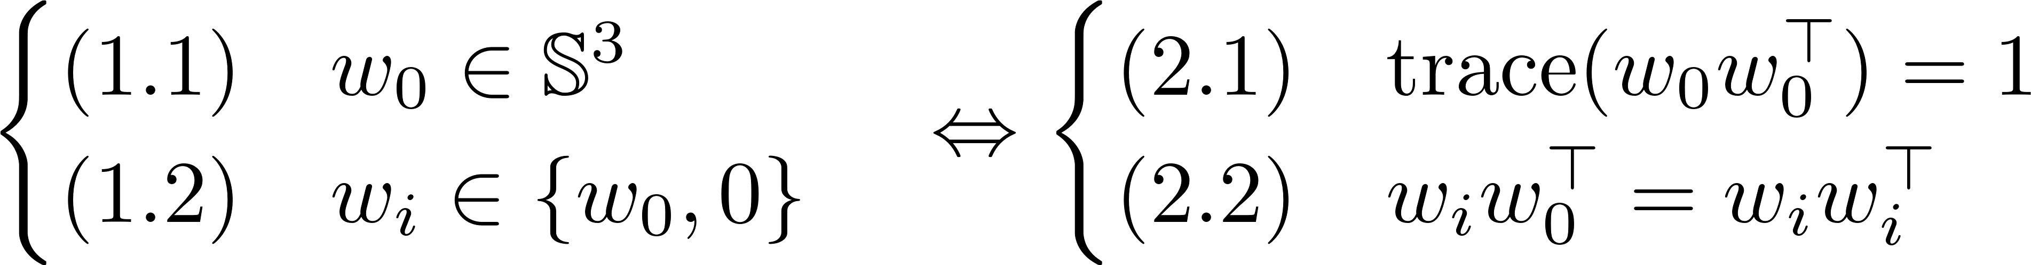
From (TLS-Q) to (QCQP) 3/4
(TLS-R) (TLS-Q) (QCQP) (SDR)
Quadratic Obj.
Constraints are also quadratic:

Slide 14
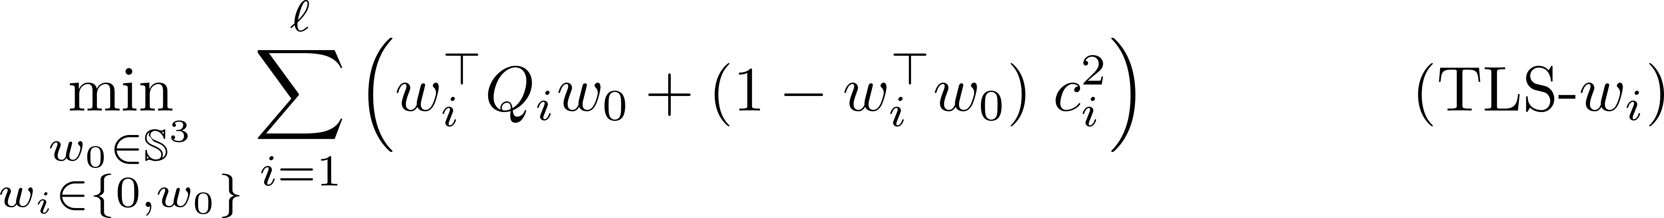
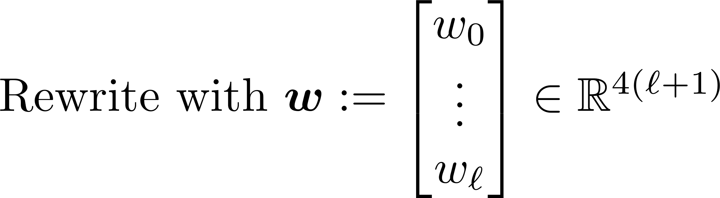
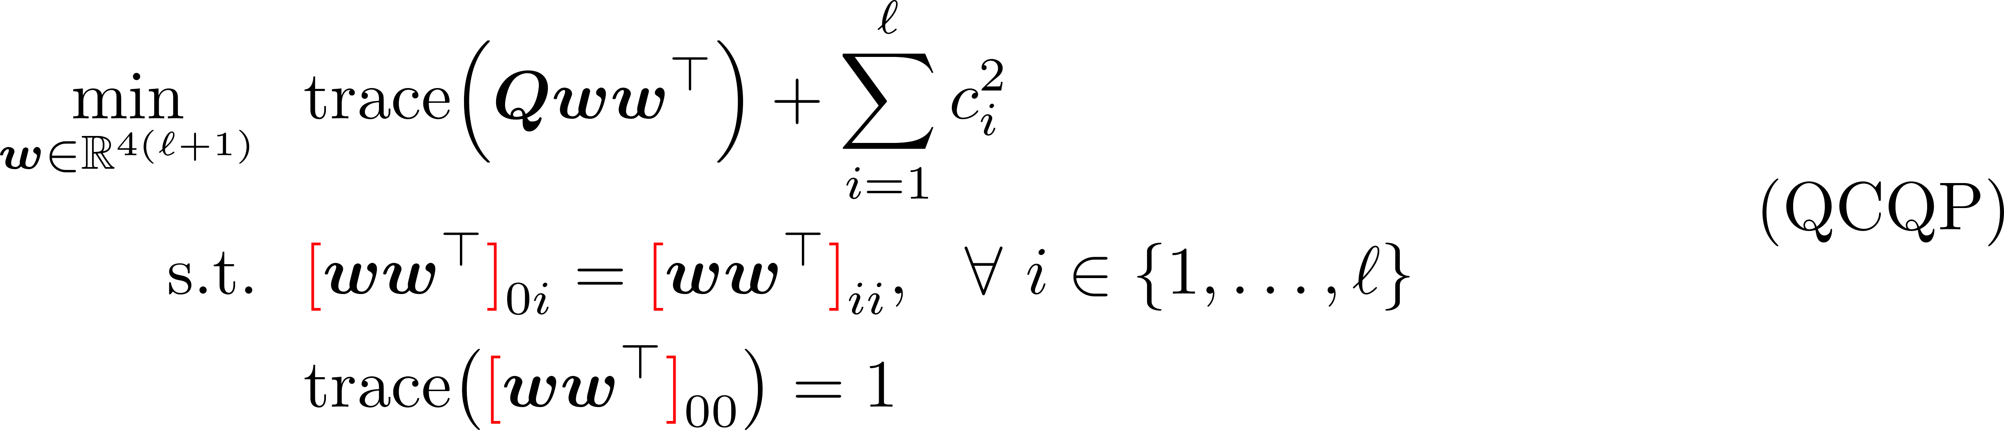
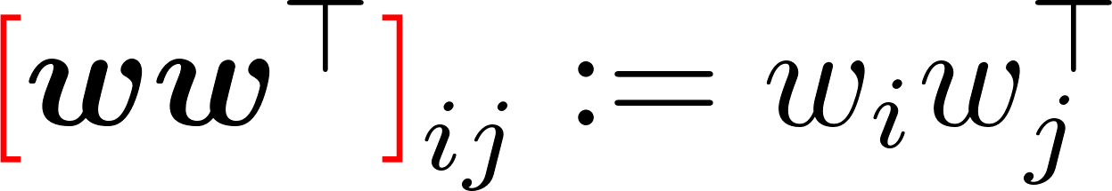
From (TLS-Q) to (QCQP) 4/4
(TLS-R) (TLS-Q) (QCQP) (SDR)

Slide 15

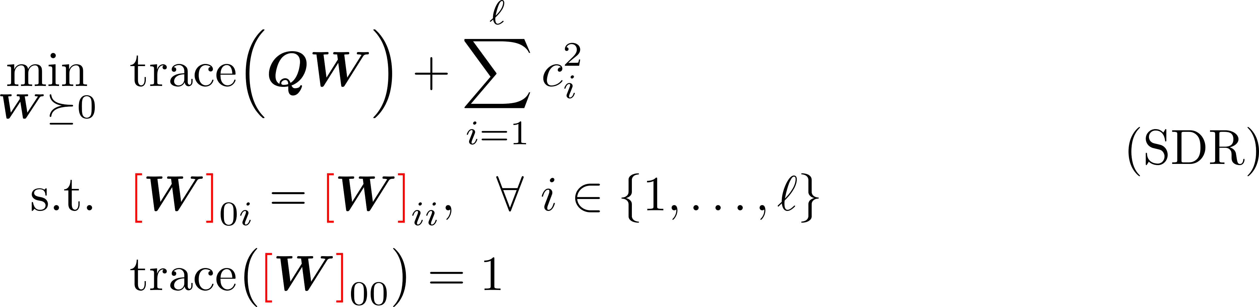
From (QCQP) to (SDR)
(TLS-R) (TLS-Q) (QCQP) (SDR)
Lifting

Slide 16
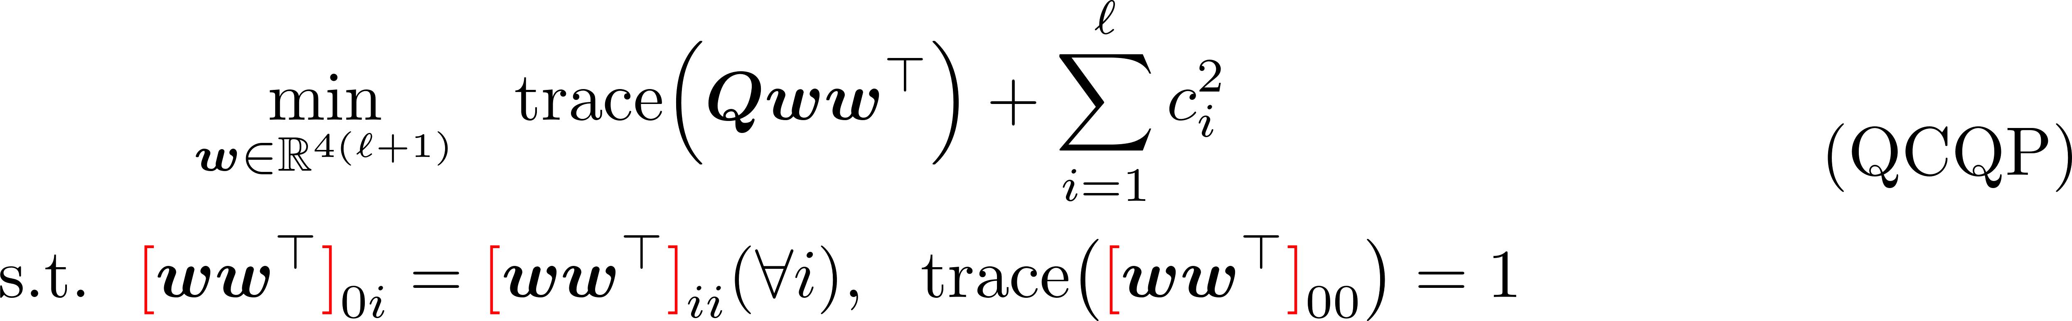
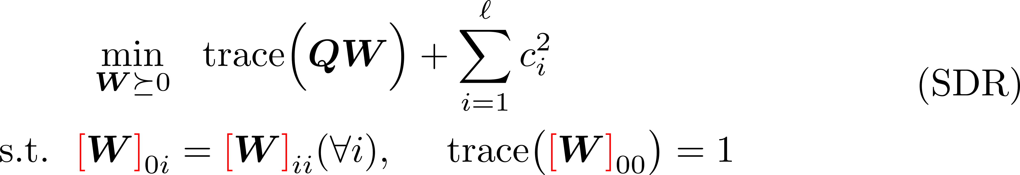
Tightness of (SDR) 1/5
Definition (Tightness, mi casa es su casa):
(TLS-R) (TLS-Q) (QCQP) (SDR)

Slide 17
Tightness of (SDR) 2/5
Structure of Our Theorems:
(TLS-R) (TLS-Q) (QCQP) (SDR)
Theorem 2
without noise
with outliers
Theorem 1
without noise
without outliers
Theorem 4
with noise
with outliers
Theorem 3
with noise
without outliers

Slide 18



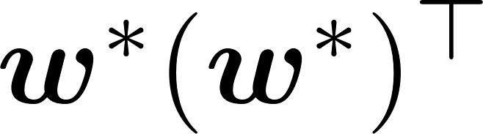
Tightness of (SDR) 3/5
Theorem 1:
(TLS-R) (TLS-Q) (QCQP) (SDR)
Ground-Truth:
Compared to [1], our proof is simpler and shorter.
[1] H. Yang and L. Carlone. A quaternion-based certifiably optimal solution to the Wahba problem with outliers. ICCV 2019.

Slide 19
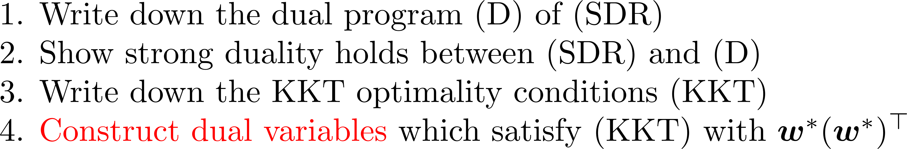
Tightness of (SDR) 4/5
Theorem 1:
(TLS-R) (TLS-Q) (QCQP) (SDR)
Ground-Truth:
High-Level Proof Idea:
L. Peng, M. Fazlyab, R. Vidal, Semidefinite relaxations of truncated least-squares in robust rotation search: Tight or not, ECCV 2022

Slide 20
Tightness of (SDR) 5/5
The rest theorems (Informal):
(SDR) is not tight for “adversarial” outliers
even without noise
(SDR) is tight for small noise and random outliers
The rest of the paper:
some propositions about geometry & probability

Slide 21
Future Works (Part I)
Analyze a tighter relaxation of robust rotation search [1]
E.g. at the second relaxation order of the Lasserre hierarchy
Empirically very tight, little to none theoretical justification
Extend the analysis to related geometric vision problems
Particularly for the truncated least-squares loss
See [2] for several examples
General Message: Classic geometric vision problems are far from being well-understood from a theoretical point of view
Modern tools from optimization, probability are needed to do so
[1] H. Yang and L. Carlone. A quaternion-based certifiably optimal solution to the Wahba problem with outliers. ICCV 2019.
[2] H. Yang and L. Carlone. Certifiably optimal outlier-robust geometric perception: Semidefinite relaxations and scalable global optimization. T-PAMI 2022.

Slide 22
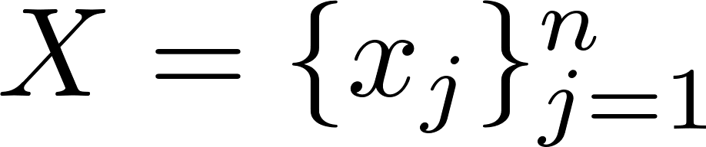
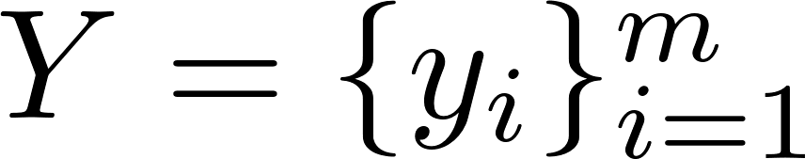
Part II: Algorithm
ARCS: Accurate Rotation and Correspondences Search
CVPR 2022
Liangzu Peng, Manolis C. Tsakiris, René Vidal
Correspondence-Less (Partially Overlapped)
additive noise
Goal:

Slide 23
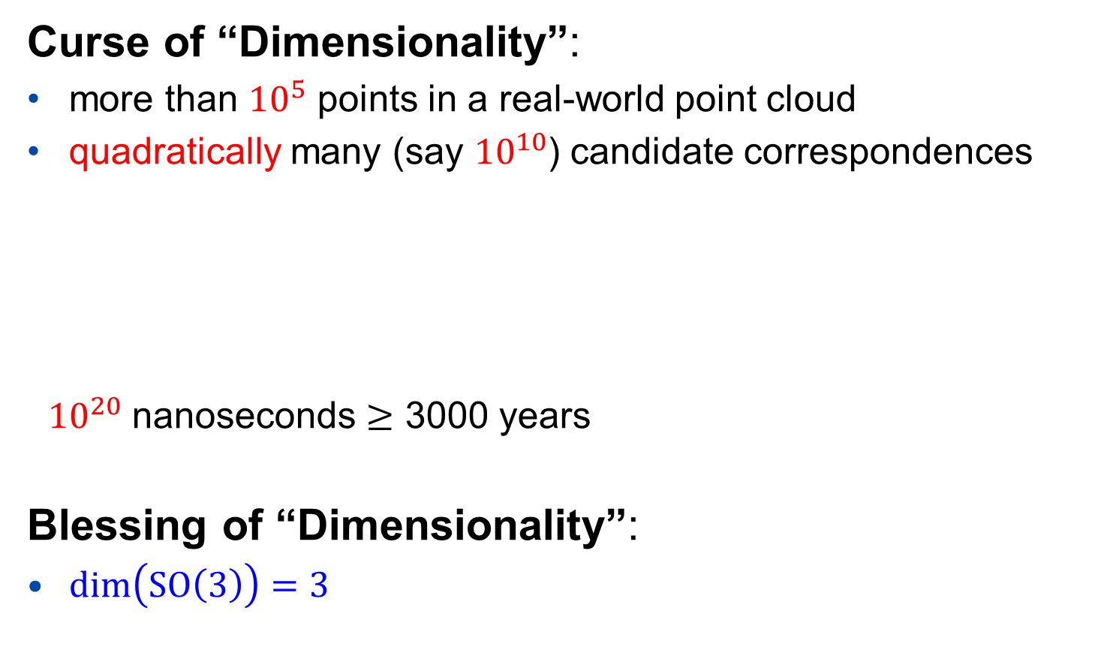
The Curse and Blessing
Curse of “Dimensionality”:
more than ${10}^{5}$ points in a real-world point cloud
quadratically many (say ${10}^{10}$) candidate correspondences
${10}^{20}$ nanoseconds $≥$ 3000 years
Blessing of “Dimensionality”:
$\dim\left(SO\left(3\right)\right)=3$
“Quadratic algorithms are useless
in modern applications.”
------ Robert Sedgewick

Slide 24
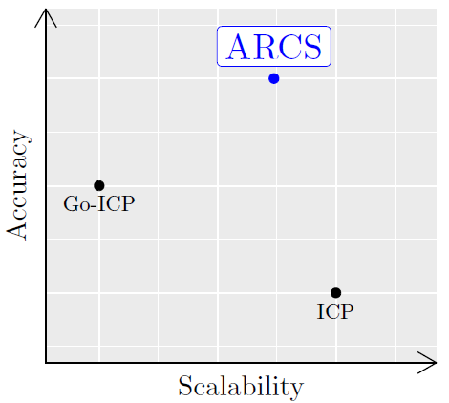
State of The Art
The ICP algorithm (and its variants)
+ preform well if adequately initialized
+ linear-logarithmic time complexity
- fails for most initializations
The Go-ICP algorithm (and its variants)
+ initialization-free
- exponential time complexity
Our algorithm: ARCS
+ initialization-free
+ linear-logarithmic time complexity
- rotation-only
Our Algorithm
ICP: P.J. Besl, N.D. McKay, “A Method for Registration of 3-D Shapes”. TPAMI 1992.
Go-ICP: J. Yang, H. Li, D. Campbell, Y. Jia, “Go-ICP: A Globally Optimal Solution to 3D ICP Point-Set Registration”, TPAMI 2016.

Slide 25
The ARCS Algorithm
ARCS consists of three steps:
Step 1: Establish Correspondences
Step 2: Outlier Removal
Step 3: Rotation Estimation/Refinement

Slide 26
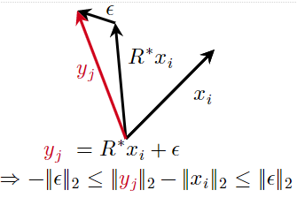
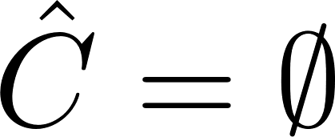
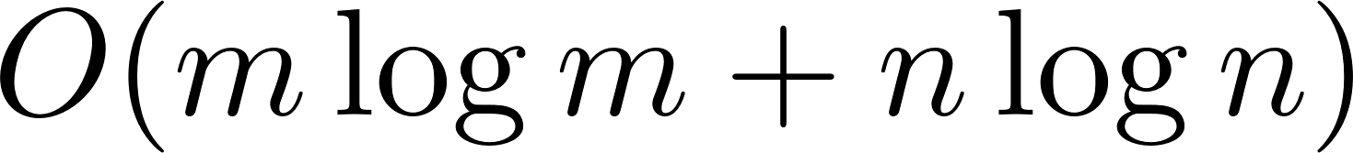
The ARCS Algorithm: Step 1
Step 1: Establish Correspondences
Initialization:
For every i=1,…,m, and j=1,…,n
Key Idea:
Step 1 can be implemented in linear-logarithmic time
Step 1 reduces the correspondence-less problem to Robust Rotation Search

Slide 27
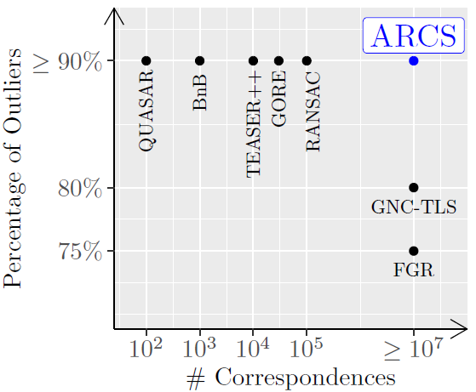

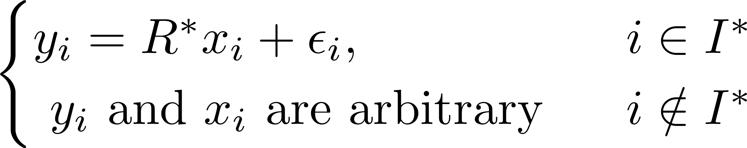
State of The Art
Our Solution (ARCS, Steps 2 and 3)
Robust Rotation Search Algorithms

Slide 28
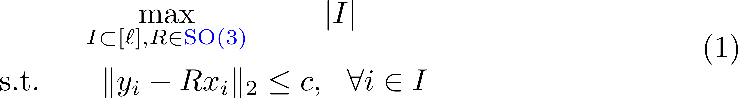
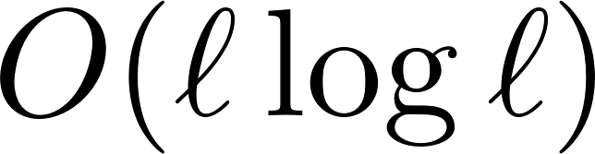
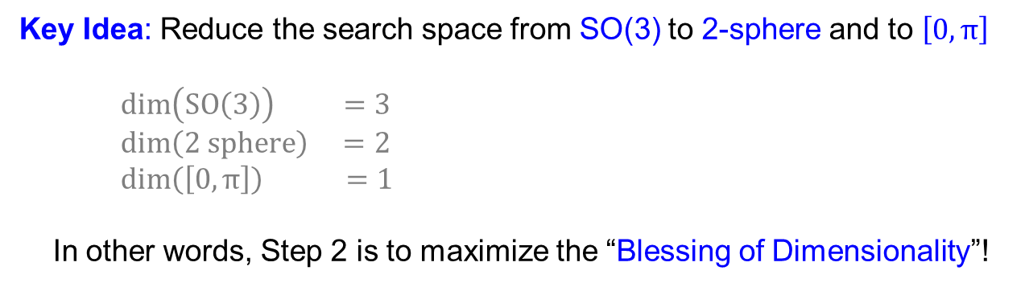
Step 2 of ARCS: Outlier Removal 1/2
Consensus Maximization: Maximize the size of the inlier set I
In general NP-hard [1] (any feasible point is a local minimizer)
Claim:
(1) can be solved approximately in linear-logarithmic time
Key Idea: Reduce the search space from SO(3) to 2-sphere and to $\left[0,π\right]$
$\dim\left(SO\left(3\right)\right) =3$
$\dim\left(2 sphere\right) =2$
$\dim\left(\left[0,π\right]\right) =1$
In other words, Step 2 is to maximize the “Blessing of Dimensionality”!
[1]: T. Chin, Z. Cai, F. Neumann, Robust Fitting in Computer Vision:
Easy or Hard?, IJCV 2020

Slide 29
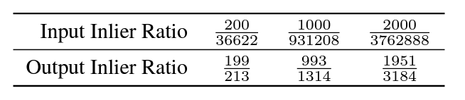
Step 2 of ARCS: Outlier Removal 2/2
Performance of Step 2
More than 3 million outlier point pairs are removed!
The final step:
Refine the rotation on the remaining point pairs
In the paper, we consider random, non-adversarial outliers

Slide 30
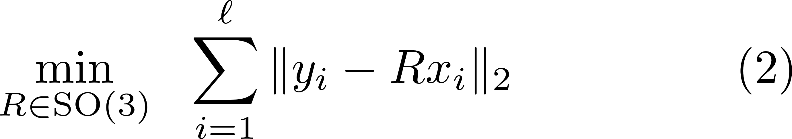
Step 3 of ARCS: Rotation Refinement 1/3
“Sum of Unsquared Deviations”:
Non-Convex (due to the constraint)
Non-Smooth (due to the objective)
The First Thought:
Riemannian Subgradient Descent
Problem: hard to derive theoretical guarantees
E.g., SO(3) has a determinant constraint

Slide 31
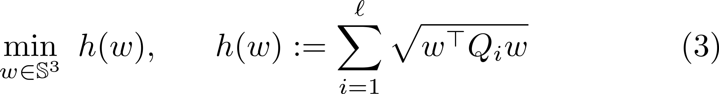
Step 3 of ARCS: Rotation Refinement 2/3
“Sum of Unsquared Deviations”:
Non-Convex (due to the constraint)
Non-Smooth (due to the objective)
The Second Thought:
Riemannian Subgradient Descent on Unit Quaternions
Claim: (2) is equivalent to

Slide 32
Step 3 of ARCS: Rotation Refinement 3/3
“Sum of Unsquared Deviations”:
Non-Convex (due to the constraint)
Non-Smooth (due to the objective)
The Final Algorithm:
Claim: Under certain regularity conditions, the algorithm converges locally at a linear rate, e.g.,

Slide 33
ARCS: Scalability & Accuracy in Numbers
ARCS is correspondence-free and can handle:
more than a million points with 2 overlapping points without noise
roughly ten thousand points with 20% overlaps under small noise
ARCS (Steps 2 and 3) can handle:
ten million point pairs with 0.03% inliers
See our paper for more formal experimental report.

Slide 34
Future Works (Part II)
Extend ARCS to the rotation + translation case
A trivial extension is in the appendix of our paper
Need a smarter and more scalable extension
Feature learning from point clouds for registration
Desiderata
It should be scalable
Should it learn differential-geometric invariance of 3D shapes？
Should it be interpretable by design? [1]
[1] Chattopadhyay et al., “Interpretable by Design: Learning Predictors by Composing Interpretable Queries” arXiv:2207.00938 [cs.CV].

Slide 35
More Information
Vision Lab @ JHU http://www.vision.jhu.edu
Center for Imaging Science @ JHU http://www.cis.jhu.edu
Mathematical Institute for Data Science @ JHU http://www.minds.jhu.edu
Thank You!

